Slide 1
Cascading Style Sheet 3.0
Lesson 2: Working with Text and Fonts

Slide 2

Lesson Objectives
Text Formatting
Text Effects
Fonts
Custom Fonts

Slide 3
Text Formatting
Following properties can be specified with the text formatting
  Text Color
  Text Alignment
  Text Decoration
  Text Transformation
  Text Indentation
  Text Shadow
  Word-wrap
Notes:
Text Color :The color property is used to set the color of the text.
Text Alignment:The text-align property is used to set the horizontal alignment of a text.
Text can be centered, or aligned to the left or right, or justified.
Text Decoration:The text-decoration property is used to set or remove decorations from text.
The text-decoration property is mostly used to remove underlines from links for design purposes:
Text Transformation:The text-transform property is used to specify uppercase and lowercase letters in a text.
It can be used to turn everything into uppercase or lowercase letters, or capitalize the first letter of each word.
Text Indentation:The text-indentation property is used to specify the indentation of the first line of a text.
Text Shadow: In CSS3, the text-shadow property applies shadow to text
Word Wrapping:In CSS3, the word-wrap property allows you to force the text to wrap - even if it means splitting it in the middle of a word

Slide 4
Text Color
Color property can be specified as follows:
  a HEX value - like "#ff0000"
  an RGB value - like "rgb(255,0,0)"
  a color name - like "red“
Example
  body {color:blue;}
  h1 {color:#00ff00;}
  h2 {color:rgb(255,0,0);}

Slide 5
Text Alignment and Text Decoration
The text-align property is used to set the horizontal alignment of a text.
Example:
  h1 {text-align:center;}
  p.date {text-align:right;}
  p.main {text-align:justify;}
The text-decoration property is used to set or remove decorations from text.
Example:
  h1 {text-decoration:overline;}
  h2 {text-decoration:line-through;}
  h3 {text-decoration:underline;}
  h4 {text-decoration:blink;}

Slide 6
Text Transformation and Text Indentation
The text-transform property is used to specify uppercase and lowercase letters in a text.
Example
  p.uppercase {text-transform:uppercase;}
  p.lowercase {text-transform:lowercase;}
  p.capitalize {text-transform:capitalize;}
The text-indentation property is used to specify the indentation of the first line of a text.
Example
  p {text-indent:50px;}

Slide 7

Text Shadow
In CSS3, the text-shadow property applies shadow to text.
You specify the horizontal shadow, the vertical shadow, the blur distance, and the color of the shadow:
Ex: Add a shadow to a header:
h1
{
text-shadow: 5px 5px 5px #FF0000;
}

Slide 8
Word wrap
word-wrap property allows you to force the text to wrap - even if it means splitting it in the middle of a word
Ex:
  Allow long words to be able to break and wrap onto the next line:
  P
  {
  word-wrap : break-word;
  }
Notes:
New Text Properties:
hanging-punctuation:Specifies whether a punctuation character may be placed outside the line box
punctuation-trim:Specifies whether a punctuation character should be trimmed
text-align-last:Describes how the last line of a block or a line right before a forced line break is aligned when text-align is "justify"
text-emphasis:Applies emphasis marks, and the foreground color of the emphasis marks, to the element's text
text-justify:Specifies the justification method used when text-align is "justify"
text-outline:Specifies a text outline
text-overflow:Specifies what should happen when text overflows the containing element
text-shadow:Adds shadow to text
text-wrap:Specifies line breaking rules for text
word-break:Specifies line breaking rules for non-CJK scripts
word-wrap:Allows long, unbreakable words to be broken and wrap to the next line

Slide 9
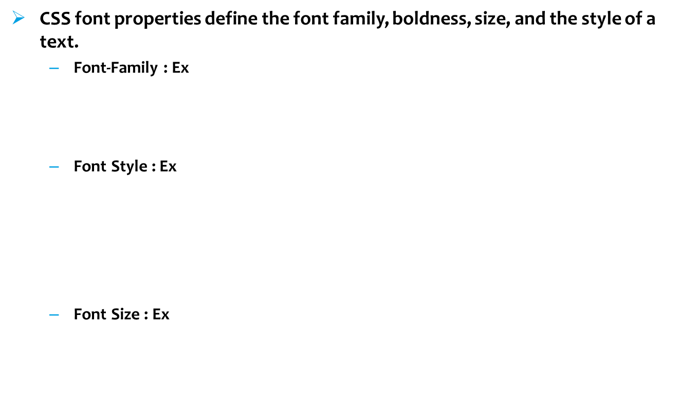
Font
      p{font-family:"Times New Roman", Times, serif;}
      p.normal {font-style:normal;}
      p.italic {font-style:italic;}
      p.oblique {font-style:oblique;}
      h1 {font-size:40px;}
      p {font-size:14px;}
Notes:
Font Family:The font family of a text is set with the font-family property.
If the name of a font family is more than one word, it must be in quotation marks, like font-family: "Times New Roman".
More than one font family is specified in a comma-separated list
Font Style:The font-style property is mostly used to specify italic text.
This property has three values:
normal - The text is shown normally
italic - The text is shown in italics
oblique - The text is "leaning" (oblique is very similar to italic, but less supported)
Font Size : Setting the text size with pixels gives you full control over the text size:
It can be set either using px attribute or em attribute as follows:
h1 {font-size:40px;}
h1 {font-size:2.5em;}
Note:The em size unit is recommended by the W3C.
1em is equal to the current font size. The default text size in browsers is 16px. So, the default size of 1em is 16px.
The size can be calculated from pixels to em using this formula: pixels/16=em

Slide 10
CSS3 Font
In CSS3 web designers are allowed to use any fonts they like.
The font file should be included in the web server and it will be automatically downloaded to user when needed.
Your "own" fonts are defined in the CSS3 with @font-face rule.
Ex:
@font-face
{
font-family: myFirstFont;
src: url('Sansation_Light.ttf'),
url('Sansation_Light.eot'); /* IE9+ */
}
div
{
font-family:myFirstFont;
}
Notes:
Using Bold text with @font-face:
@font-face
{
font-family: myFirstFont;
src: url('Sansation_Bold.ttf'),
url('Sansation_Bold.eot'); /* IE9+ */
font-weight:bold;
}
The file "Sansation_Bold.ttf" is another font file, that contains the bold characters for the Sansation font.
Browsers will use this whenever a piece of text with the font-family "myFirstFont" should render as bold.
This way you can have many @font-face rules for the same font.

Slide 11
Demo : Text and Font
Lesson02
  demoFontText.html
  word_wrap.html

Slide 12

Lesson Summary
In this lesson, you have learnt about
  Text Formatting
  Text Effects
  Fonts
  Custom Fonts
Notes:
Additional notes for instructor

Slide 13

Review Questions
Question 1:Given :
h1
{
text-shadow: A ,B ,C,D;
}
What property does C represents?
  Option 1: Colour
  Option 2: Vertical Shadow
  Option 3: Blurr
  Option 4: Horizontal Shadow
Question 2: Custom Fonts can be included with CSS 3
  Option 1: TRUE
  Option 2: FALSE
Notes:
Ans-1 : 2
Ans-2 : 2

